Slide 1

Ace of Hearts
Mia Giandinoto, Hannah Hagenau, Anna Johnson, Shivani Kulkarni, Dhruv Modi, Sherina Thomas, Matthew Tran
October 13th, 2020

Slide 2
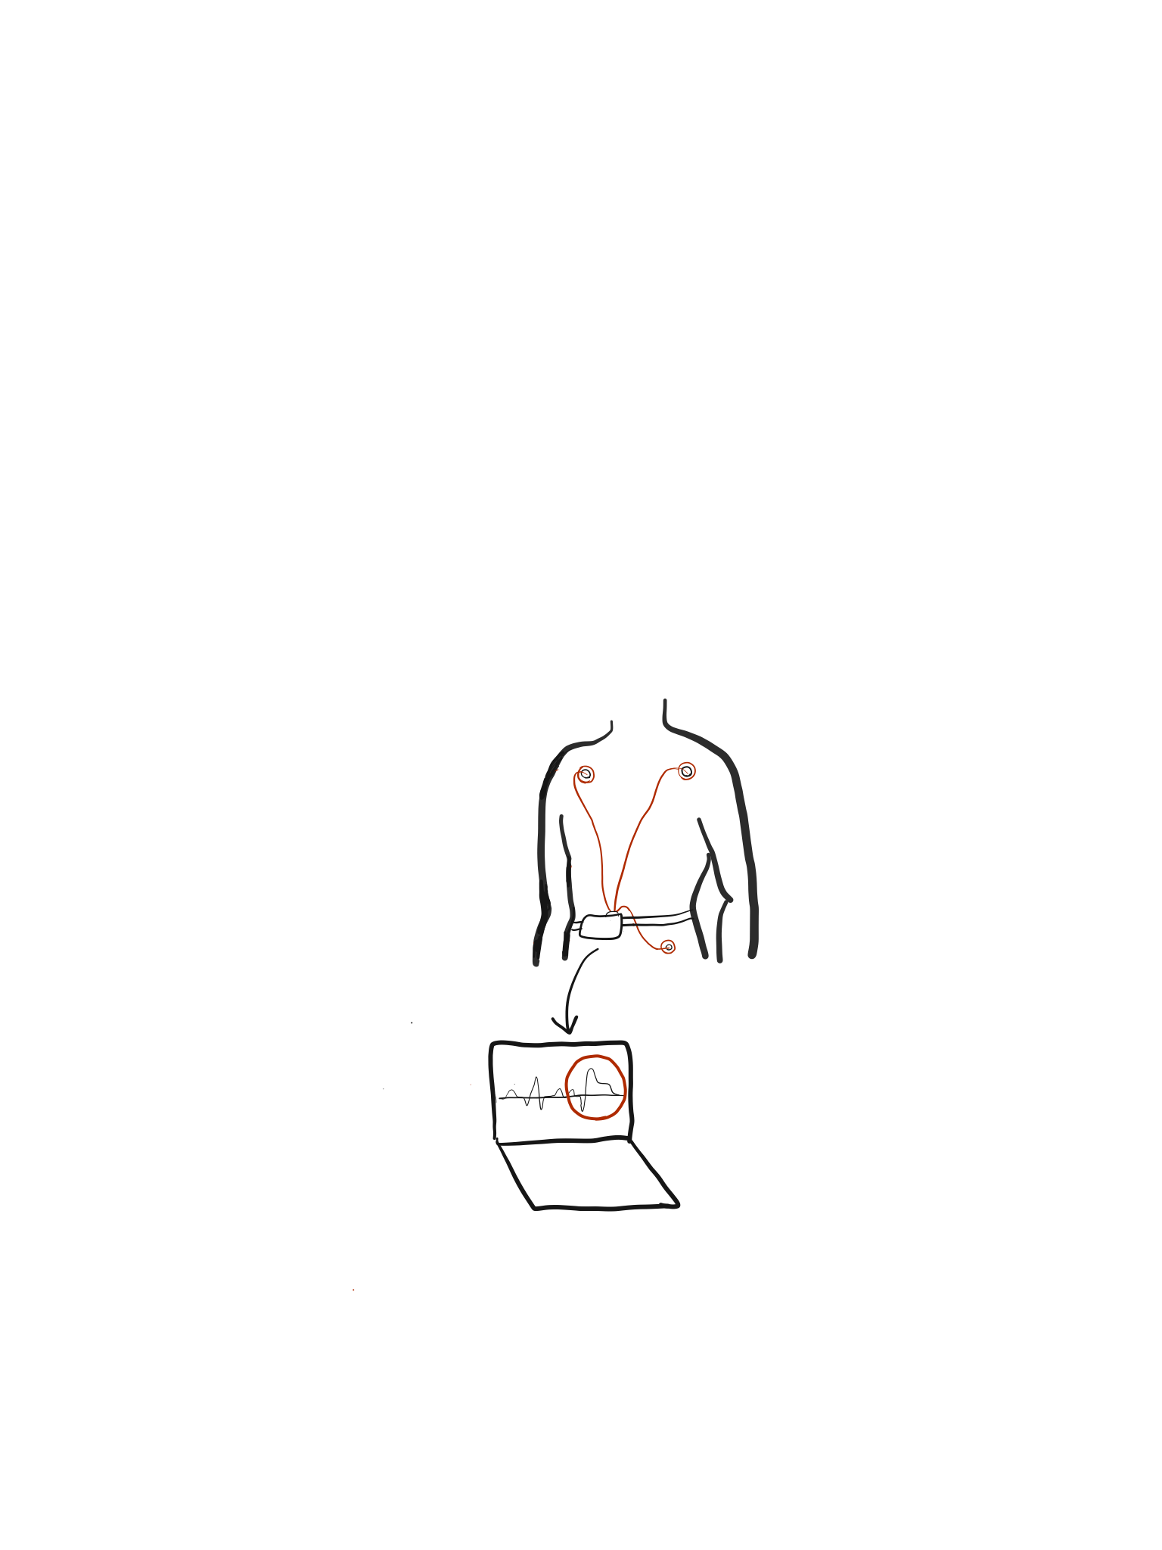
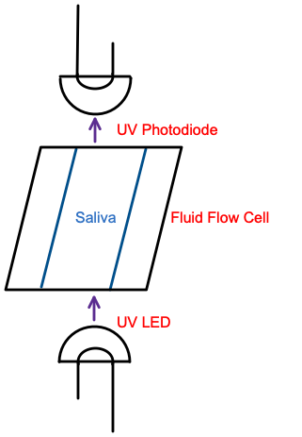
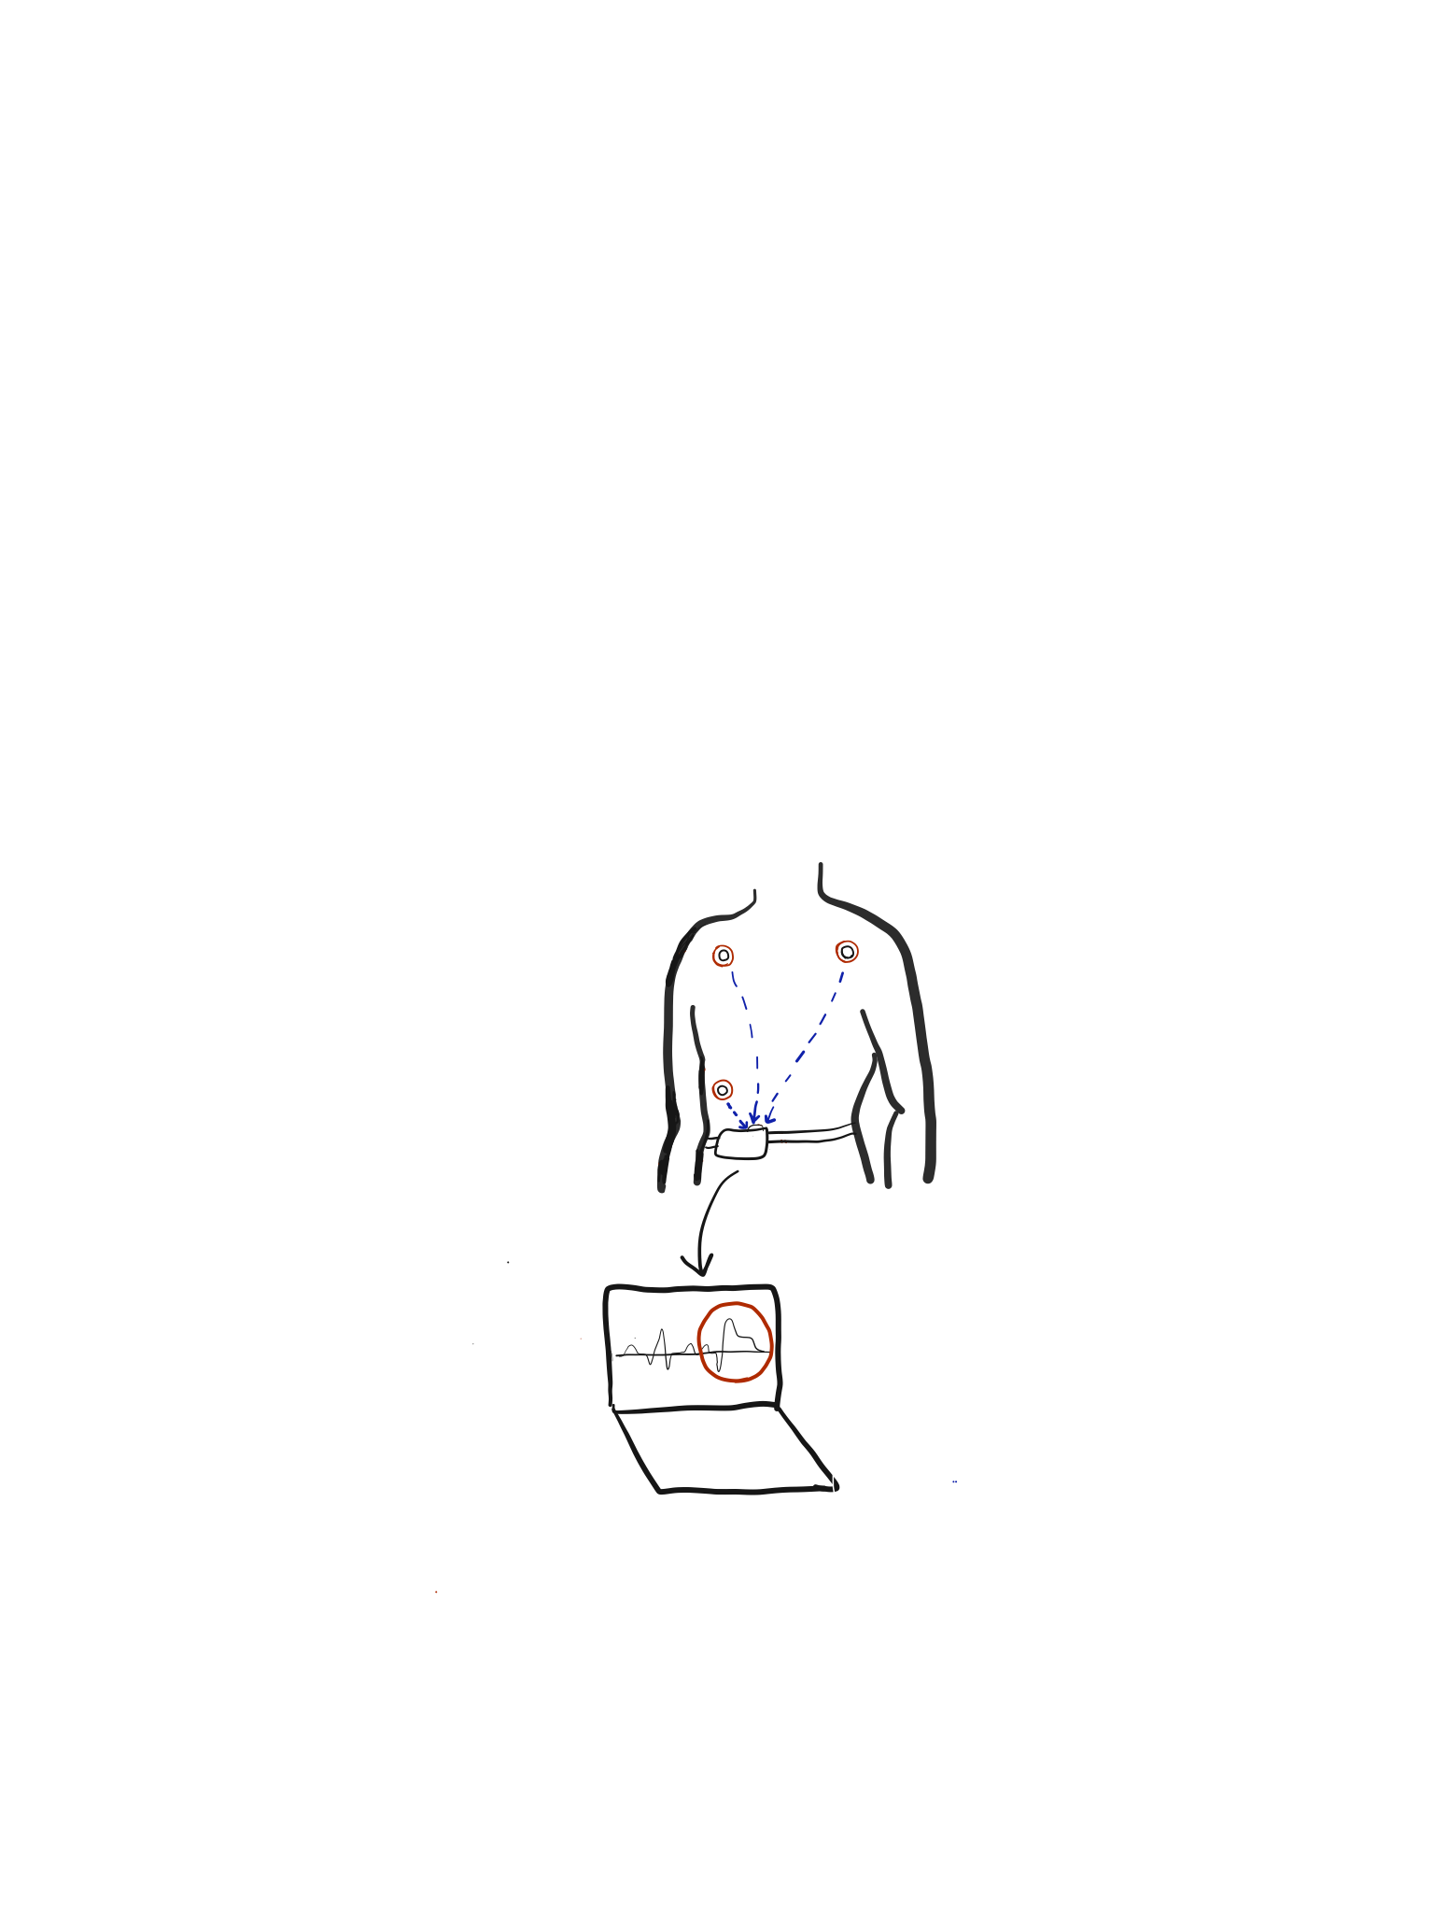
Initial Device Designs Recap
Device 1 - Portable ECG
Device 2 - UV Spectroscopy
Device 3 - Combination
+

Slide 3
Decision Matrix
(Out of 5) |  | Device #1 |  | Device #2 |  | Device #3
Criteria | Weight | Rating | Score | Rating | Score | Rating | Score
Accuracy | .15 | 4.5 | .675 | 3.5 | .525 | 4.5 | .675
Reliability | .20 | 4.5 | .900 | 3 | .600 | 3 | .600
Feasibility | .50 | 4.5 | 2.25 | 2 | 1.00 | 1 | .500
Time Sensitivity | .15 | 4 | .600 | 1.5 | .225 | 2.50 | .375
Total Score |  |  | 4.425/5 |  | 2.35/5 |  | 2.15/5
Rank |  | 1 |  | 2 |  | 3
Notes:
More slides or less words

Slide 4
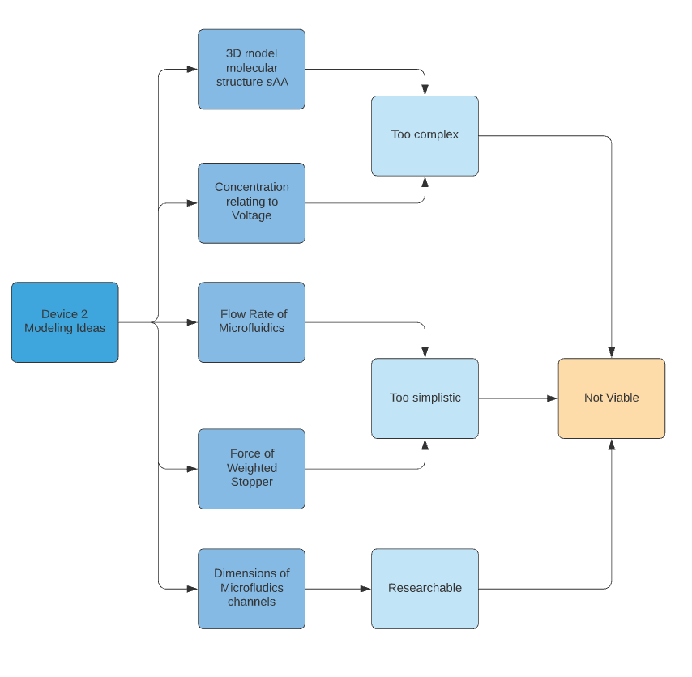
Modeling

Slide 5
Decision Matrix
(Out of 5) |  | Device #1 |  | Device #2 |  | Device #3
Criteria | Weight | Rating | Score | Rating | Score | Rating | Score
Accuracy | .15 | 4.5 | .675 | 3.5 | .525 | 4.5 | .675
Reliability | .20 | 4.5 | .900 | 3 | .600 | 3 | .600
Feasibility | .50 | 4.5 | 2.25 | 2 | 1.00 | 1 | .500
Time Sensitivity | .15 | 4 | .600 | 1.5 | .225 | 2.50 | .375
Total Score |  |  | 4.425/5 |  | 2.35/5 |  | 2.15/5
Rank |  | 1 |  | 2 |  | 3
Notes:
More slides or less words

Slide 6
Problem Definition
Create a noninvasive electrocardiogram (ECG) device to recognize and alert users to stress and symptoms of heart attacks through the parameters of the low frequency (LF)/ high frequency (HF) ratio of heart rate variability, ST segment elevation, and T wave inversion to mitigate the effects of a myocardial infarction.

Slide 7
ECG: Modeling Noise Filtration
Modeling Question
Which R-peak detection method optimizes device specificity? Which filtering method maximizes SNR and best facilitates R-peak detection?
Modeling Objective
Select the optimal filtering/r-peak detection method to denoise data and accurately detect R Peaks.
Importance
Filtering and R-peak detection provides basis for accurate HRV analysis
Results
Comparing different R Peak detection methods’ specificity on filtered signal sets
Notes:
Which combination of filtering methods best removes noise

Slide 8
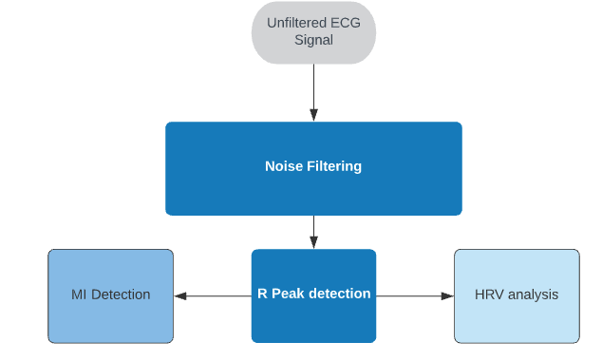
ECG Design Process
Notes:
Feature extraction left side only
Be more specific about stress level output
Missing step between MI detect and ST box
Missing box after implicit stress level output
Make shapes boxes

Slide 9
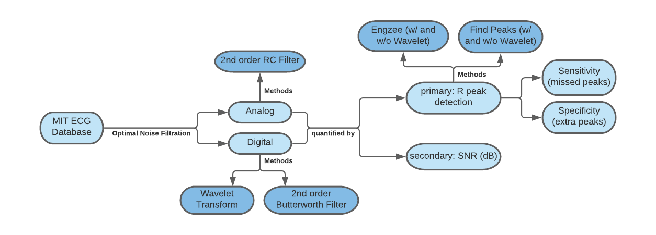
Diagrammatic Model
Notes:
Either talk about this more or make the diagram simpler
Hero’s journey of device (linear model)
Focus more on SNR, r peak detection, sensitivity vs. specificity
Roadmap of phase 2, reproducible
w/ diff models r peak detection works differently
Switch w/ slide 4, modeling question slide earlier

Slide 10
Assumptions and Constraints
Assumptions
RC transfer function replicates physical filtering
No irregularities exist in frequency pass band
Arrhythmia
Larger SNR leads to easier R-peak detection
Constraints
MIT Database has artificial noise
Extracted from actual data and added w/ various ratios
Discrete sampling (not real time)
Digital Specific

Slide 11
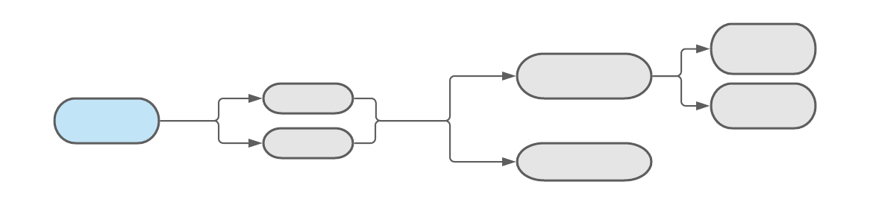
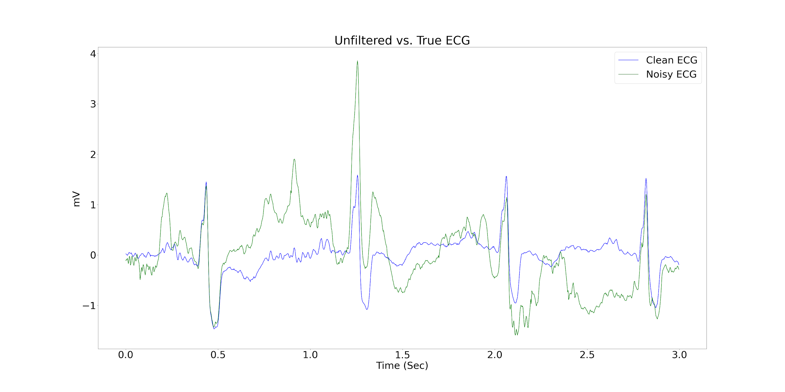
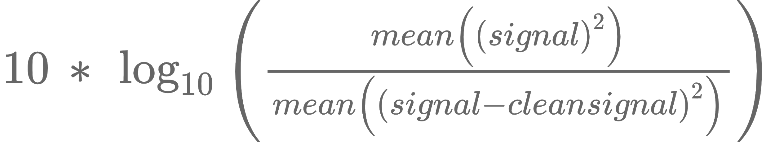
Data used for Model
MIT noise stress test database^{3,9}
Sampling Frequency of 360 Hz
Clean signal with artificially added noise
3 seconds of noisy data shown
SNR⁸ Calculated in dB:
Goal: maximize SNR value

Slide 12
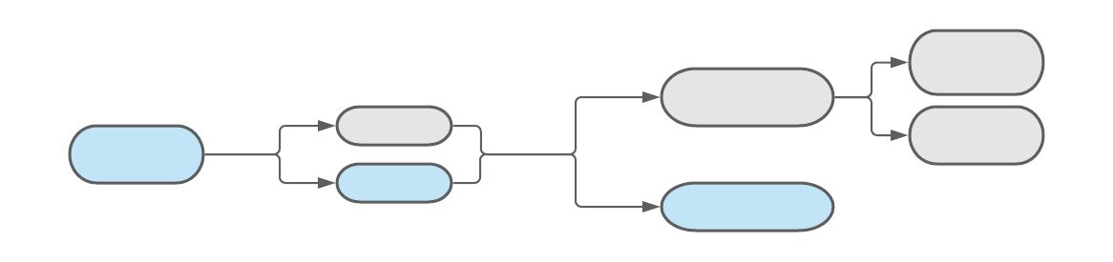
2nd Order Butterworth Filter Model
Eliminate frequencies above/below certain value
2nd Order Butter Function Models Digital Low-pass Filter under 30 Hz
Determined by Fourier transform
30 second period
Simple, fast, versatile
SNR: 0.199 dB

Slide 13
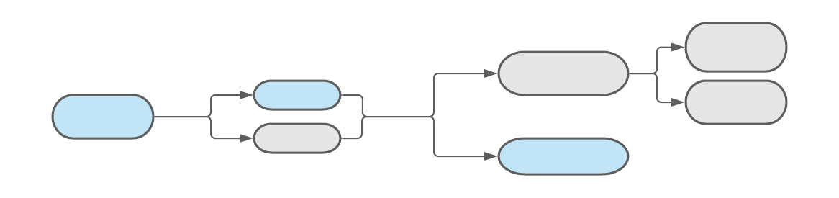
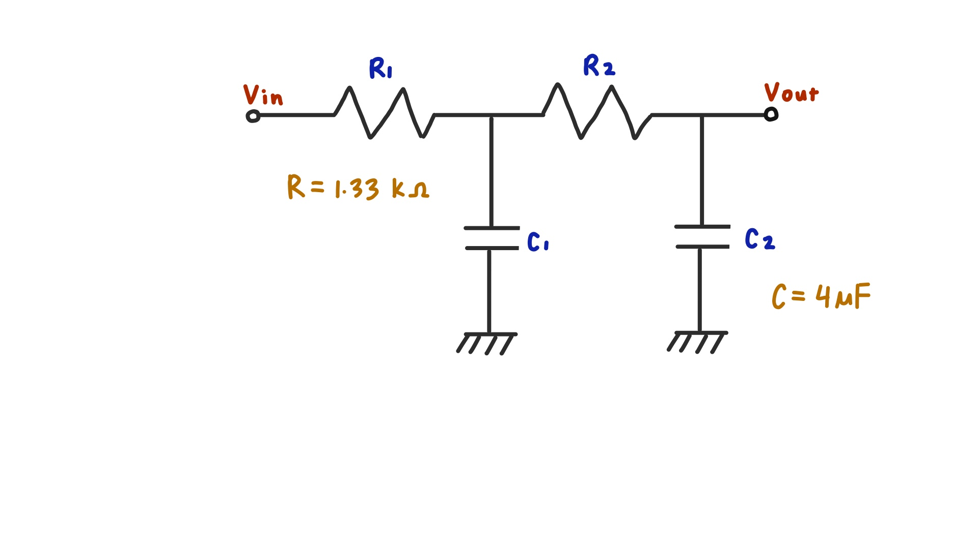
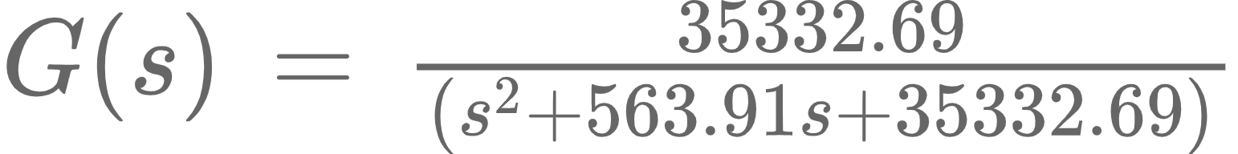
ECG: 2nd Order RC Filter Model
Mathematical:
2nd Order RC Transfer Function models Analog Low-pass Filter^{4,17}
Transfer Function:
For ~30 Hz:
SNR: -1.73 dB

Slide 14
ECG: Discrete Wavelet Transform Model
Mathematical:
Discrete wavelet transform decomposes data into series of coefficients^{8,16}
First and last coefficients zeroed out, others are thresholded⁸
Removes baseline wander and high frequency noise
SNR: -3.165 dB

Slide 15
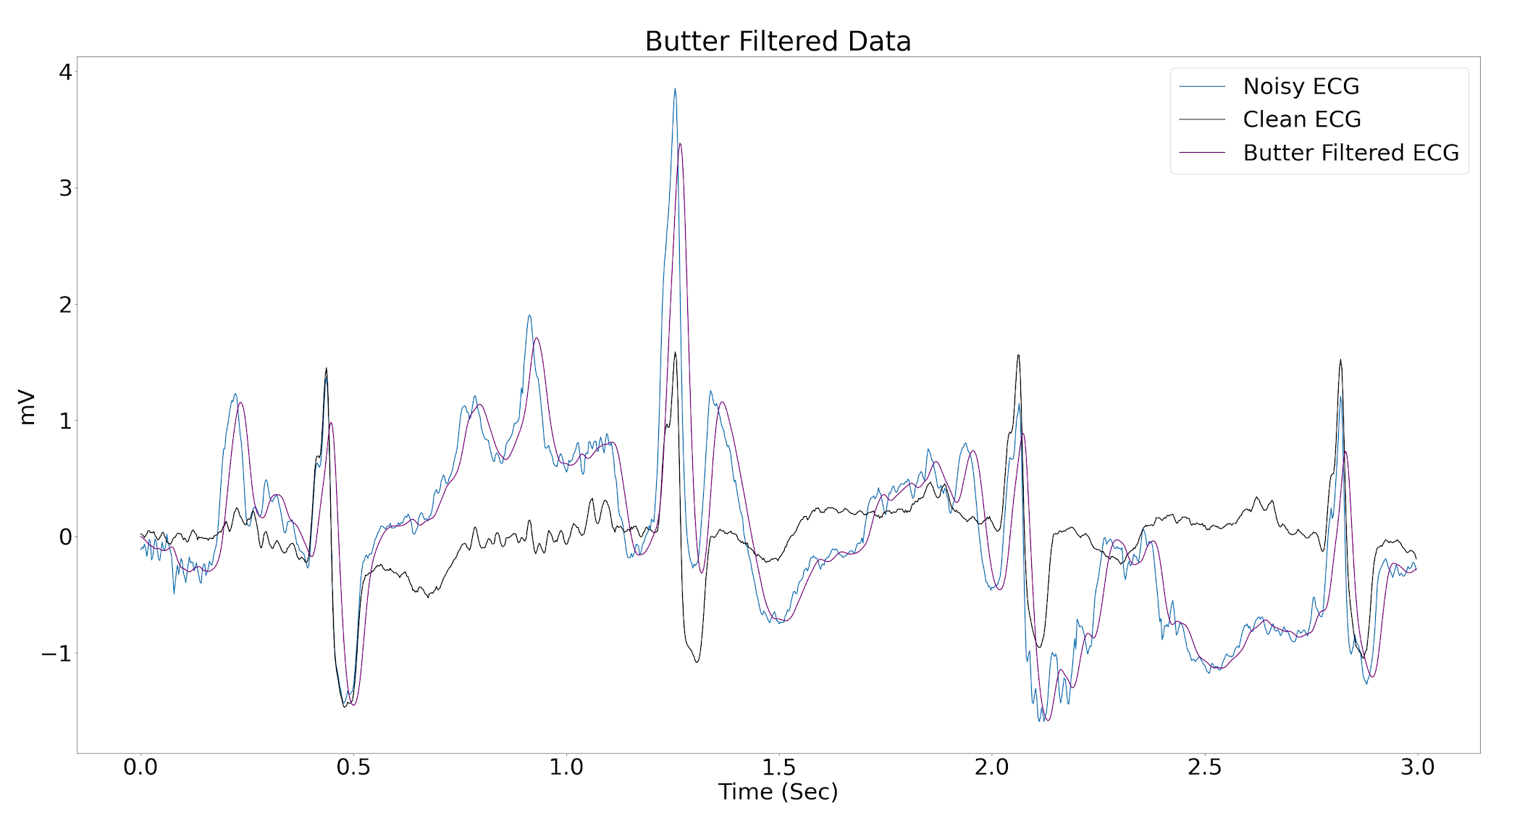

Slide 16
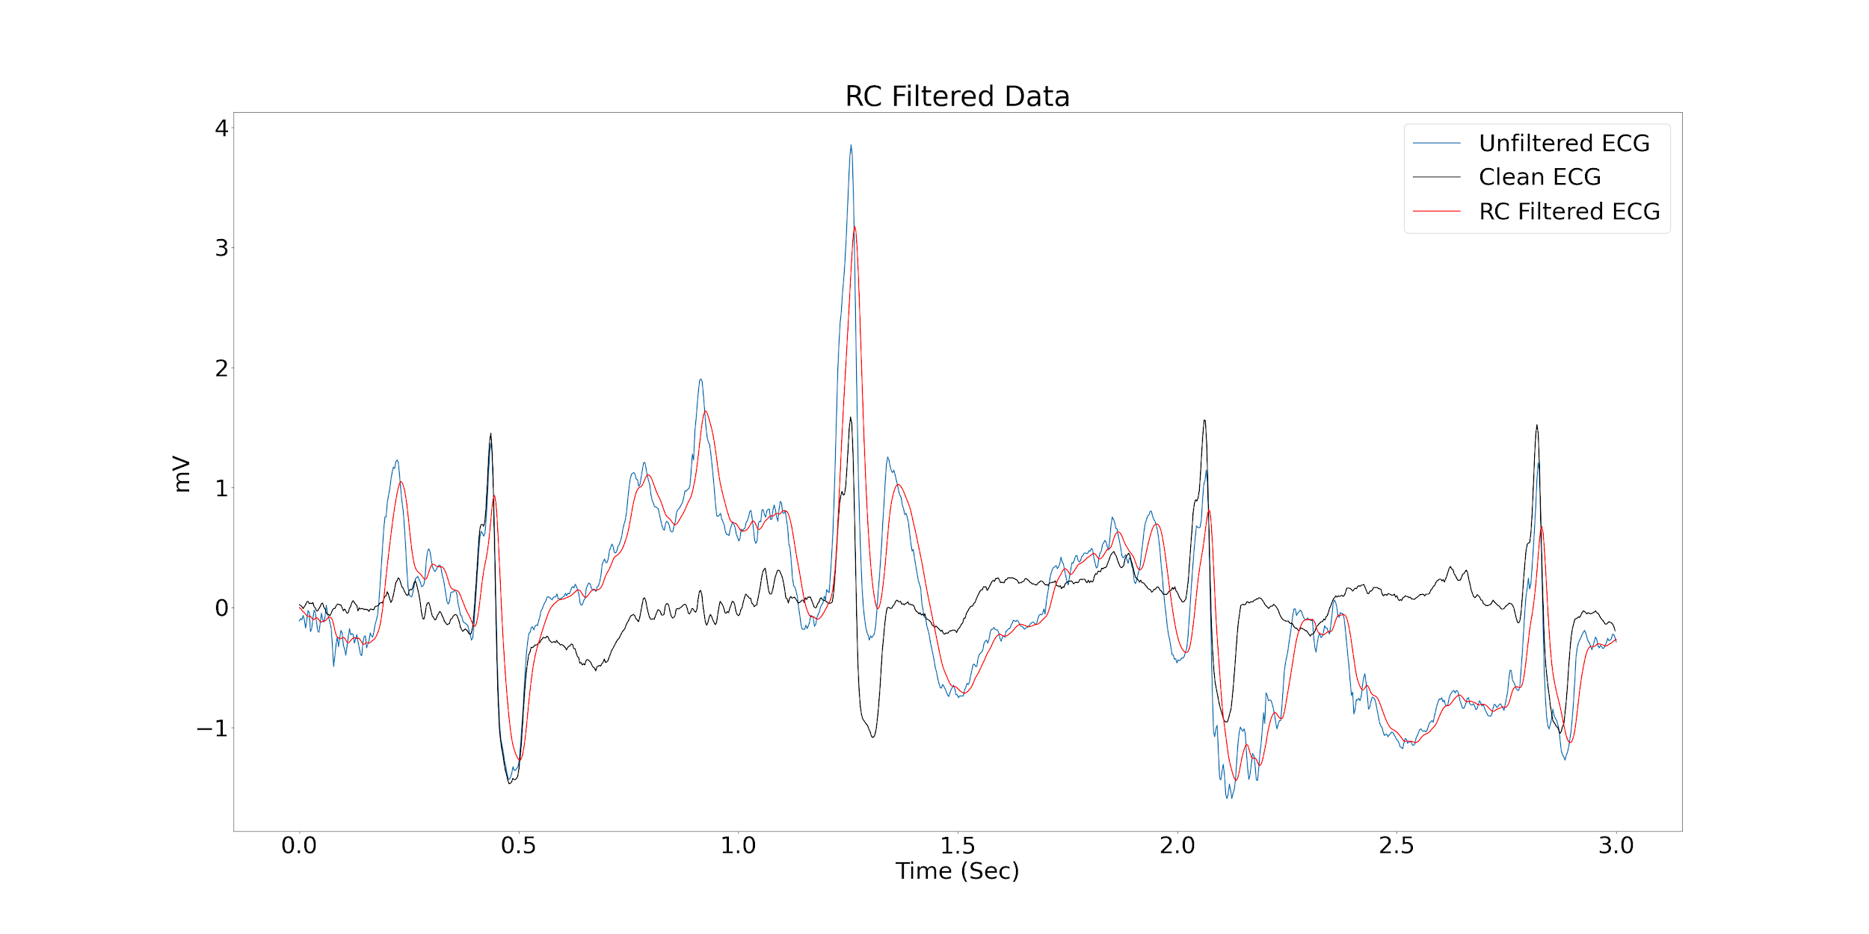

Slide 17
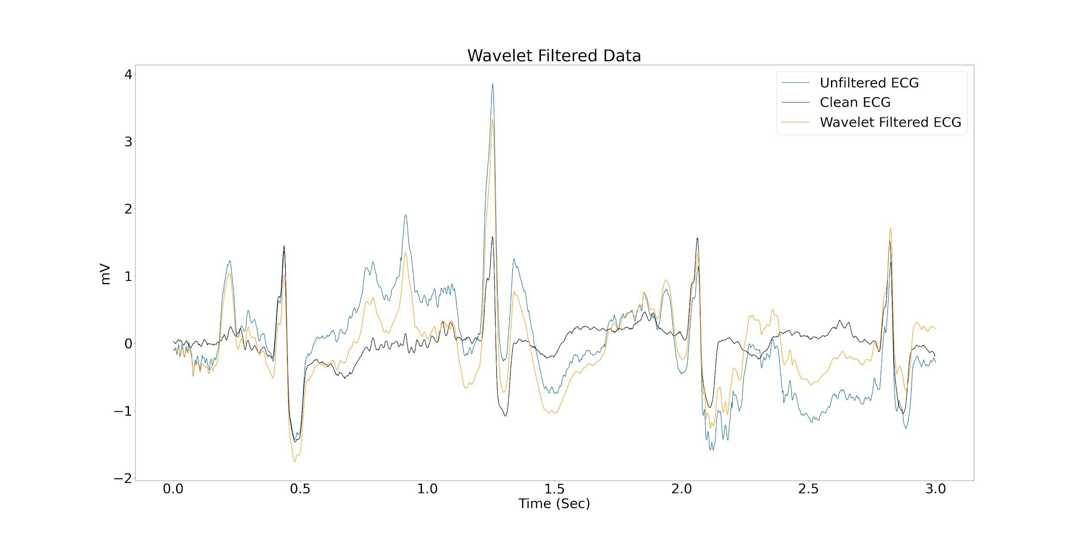

Slide 18
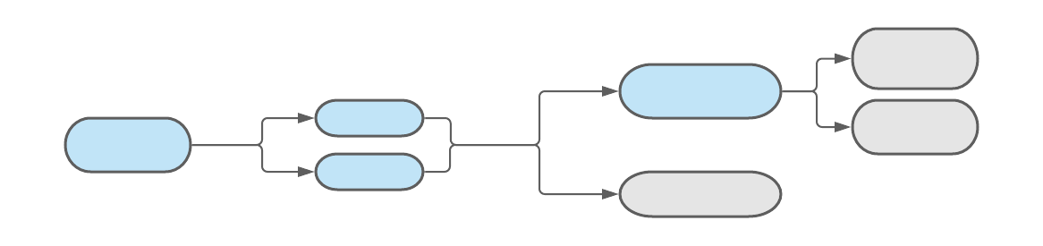
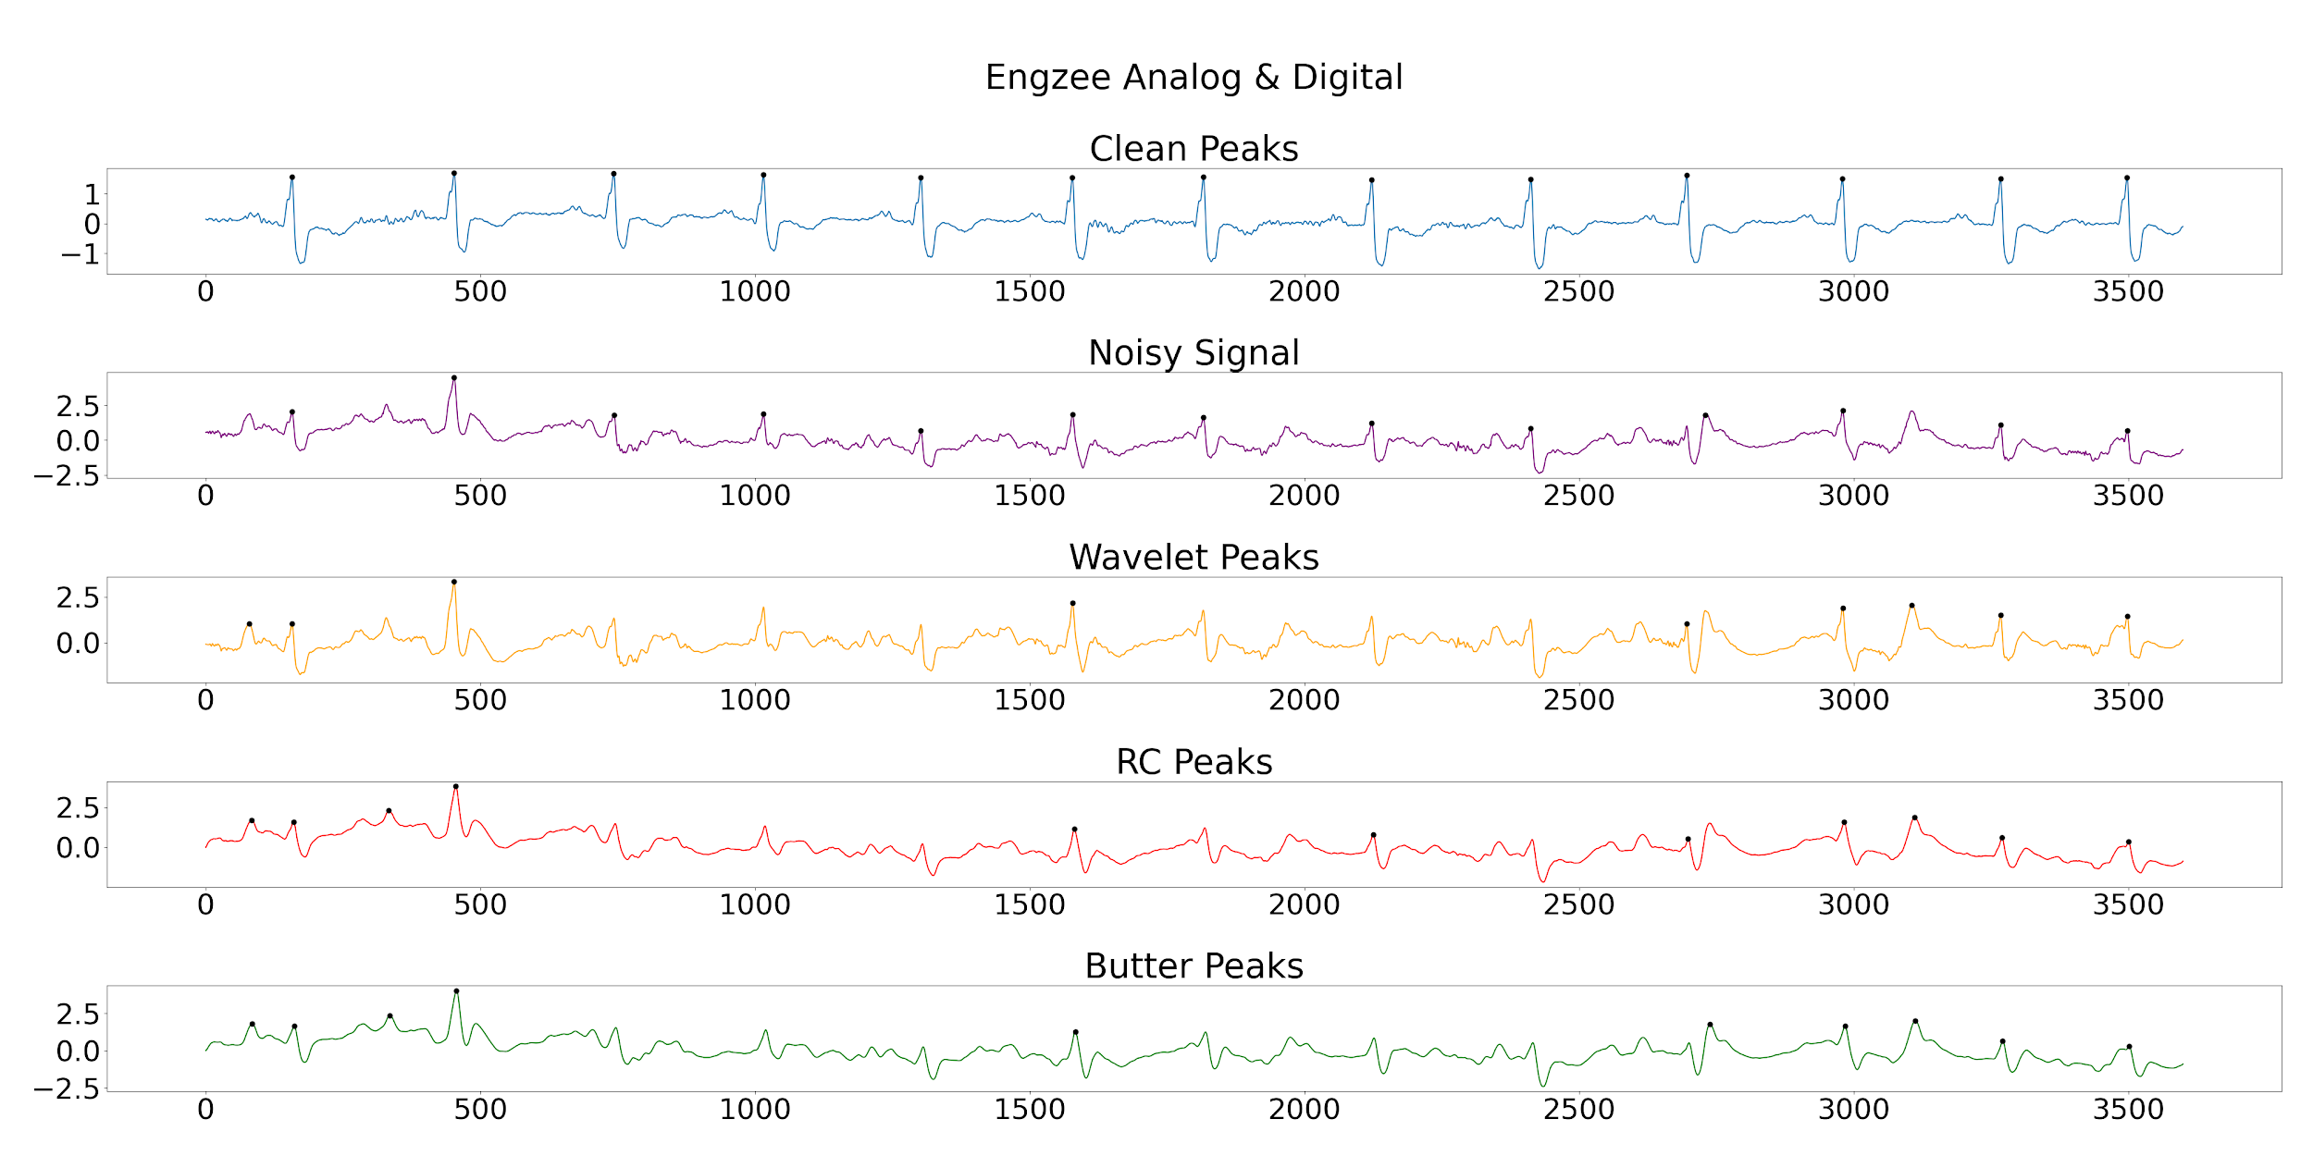
Notes:
Make rpeaks more obvious on graph

Slide 19
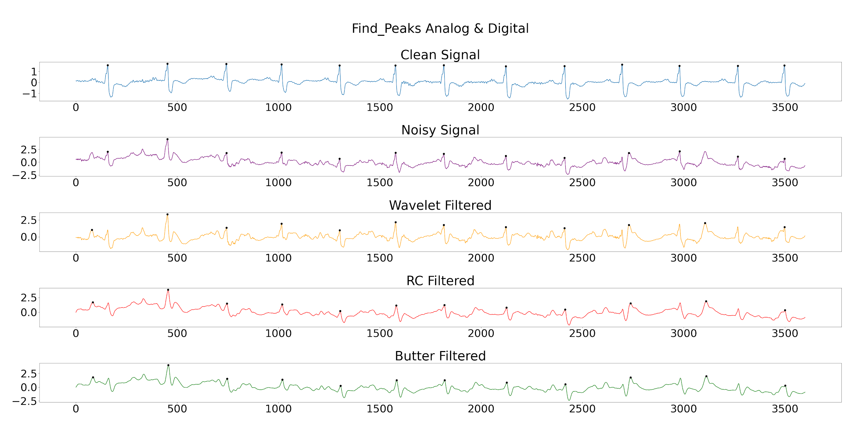

Slide 20
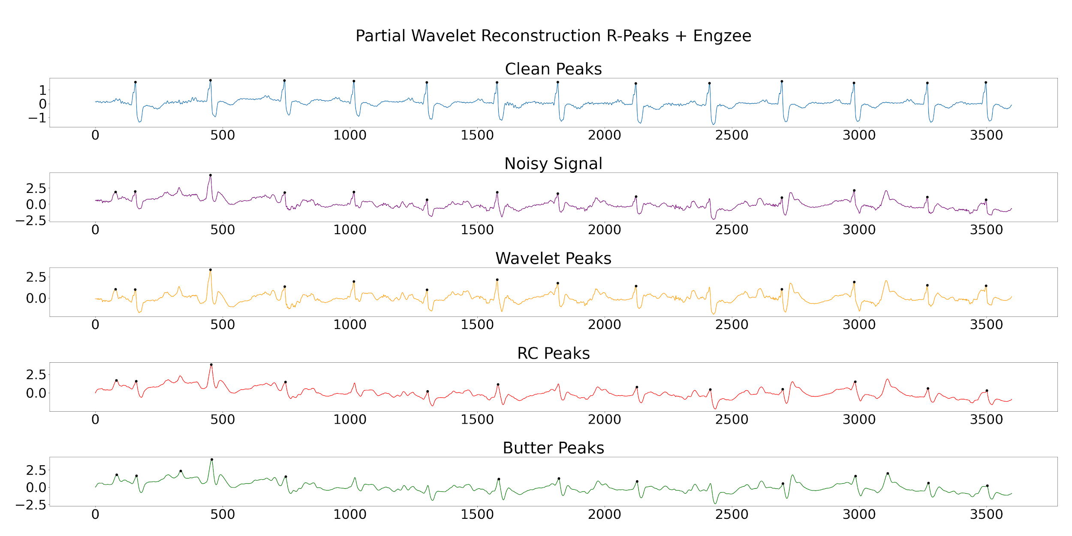

Slide 21
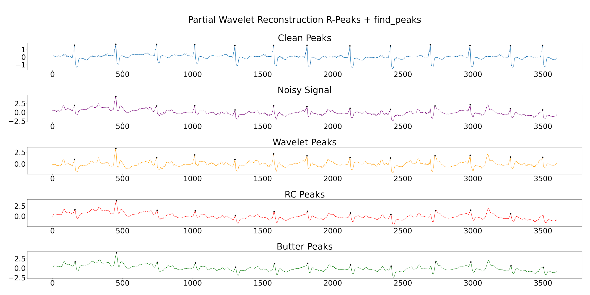

Slide 22
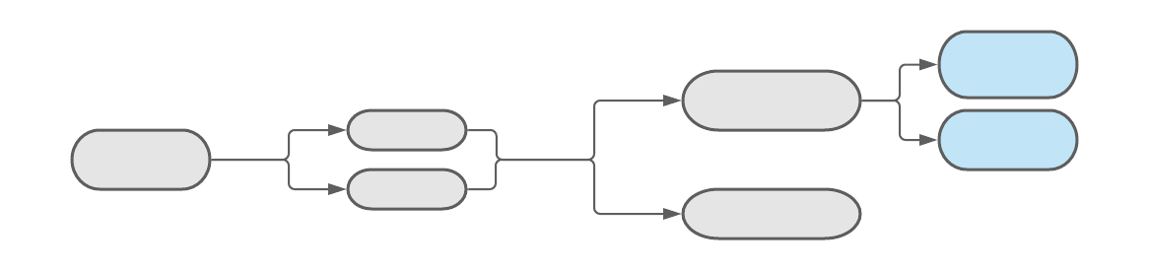
ECG: Model Results and Insights (RPeaks)
 | Butterworth | RC Filter | Wavelet Filter
Find Peaks | 0.714 0.994 | 0.714 0.994 | 0.714 0.994
Engzee Detector | 0.625 0.992 | 0.667 0.994 | 0.625 0.996
Find Peaks w/ Wavelet | 1 1 | 0.91 1 | 0.91 0.998
Engzee Detector w/ Wavelet | 0.769 0.994 | 0.83 0.998 | 0.91 0.998
SNR Difference | 16.20 | 14.27 | 12.84
Sensitivity Missed Peaks
Specificity Extra Peaks

Slide 23
Results and Implications:
Optimal combination is lowpass butterworth filter & partial wavelet transform/find_peaks

Slide 24
Next Steps
Next Steps: Phase III
1. Sliding window | 2. Test detection algorithms | 3. Detect myocardial infarction
Filter small increments for near real-time data | Use real-time data HRV analysis for LF/HF ratio | PTB database (MI patients) ST elevation T wave inversion ST depression
Questions:
Can we add a high-pass component to our butterworth filter to more effectively filter out baseline wander?
How can we more effectively remove electrode motion artifact?

Slide 25
References
Beckers, F., et al. (2006). "Aging and nonlinear heart rate control in a healthy population." American Journal of Physiology-Heart and Circulatory
Francis, J. (2016). "ECG monitoring leads and special leads." Indian Pacing and Electrophysiology Journal 16(3): 92-95.
Goldberger, A., Amaral, L., Glass, L., Hausdorff, J., Ivanov, P. C., Mark, R., ... & Stanley, H. E. (2000). PhysioBank, PhysioToolkit, and PhysioNet: Components of a new research resource for complex physiologic signals. Circulation [Online]. 101 (23), pp. E215–e220.
Hearfield, J. (2009). Designing resistor-capacitor networks. Retrieved October 11, 2020, from http://www.johnhearfield.com/RC/RC4.htm
Kumar, P., & Sharma, V. K. (2020). Detection and classification of ECG noises using decomposition on mixed codebook for quality analysis. Healthcare technology letters, 7(1), 18–24. https://doi.org/10.1049/htl.2019.0096
Lenis, G., et al. (2017). "Comparison of Baseline Wander Removal Techniques considering the Preservation of ST Changes in the Ischemic ECG: A Simulation Study." Computational and mathematical methods in medicine 2017: 9295029-9295029.
Li, K., Rüdiger, H., & Ziemssen, T. (2019). Spectral Analysis of Heart Rate Variability: Time Window Matters. Frontiers in neurology, 10, 545. https://doi.org/10.3389/fneur.2019.00545
Lin, H. Y., et al. (2014). "Discrete-wavelet-transform-based noise removal and feature extraction for ECG signals." IRBM 35(6): 351-361.
Moody GB, Muldrow WE, Mark RG(1984). “A noise stress test for arrhythmia detectors.” Computers in Cardiology 11:381-384.
Peltola, M. A. (2012). Role of editing of R–R intervals in the analysis of heart rate variability. Frontiers in Physiology, 3. doi:10.3389/fphys.2012.00148
Porr, B., & Howell, L. (2019, December 20). Berndporr/py-ecg-detectors. Retrieved October 11, 2020, from https://github.com/berndporr/py-ecg-detectors
Salsekar, B. and D. Wadhwani (2012). "Filtering of ECG signal using Butterworth Filter and its feature extraction." International Journal of Engineering Science and Technology 4.
Serhani, M. A., et al. (2020). "ECG Monitoring Systems: Review, Architecture, Processes, and Key Challenges." Sensors (Basel, Switzerland) 20(6): 1796.
Shaffer, F. and J. P. Ginsberg (2017). "An Overview of Heart Rate Variability Metrics and Norms." Frontiers in public health 5: 258-258.
Villegas, A., et al. (2019). "Arm-ECG Wireless Sensor System for Wearable Long-Term Surveillance of Heart Arrhythmias." Electronics 8(11): 1300.
Verma, Ajay. [Dr. Ajay Verma].(2020, Feb 13). Introduction to Wavelet Theory and its Applications. [Video]. Youtube. https://youtu.be/F_QvT_8kOfc
2nd order CR filter Design tools. (n.d.). Retrieved October 11, 2020, from http://sim.okawa-denshi.jp/en/CRCRkeisan.htm

Slide 26
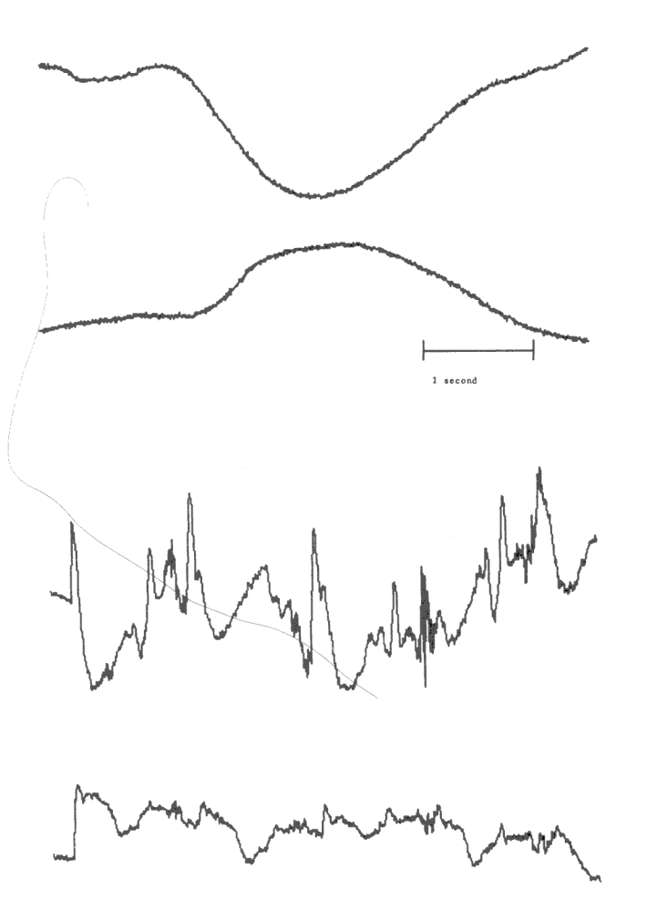
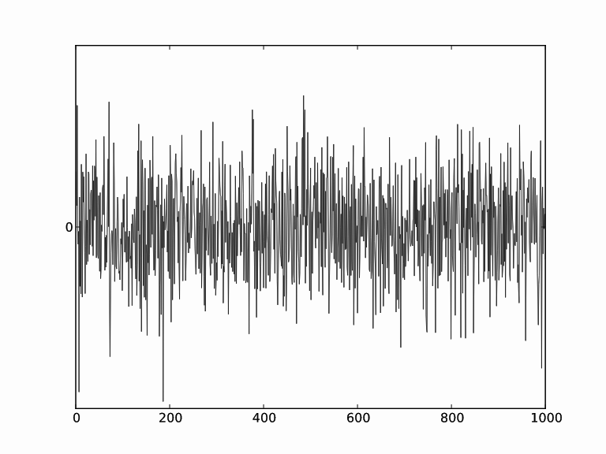
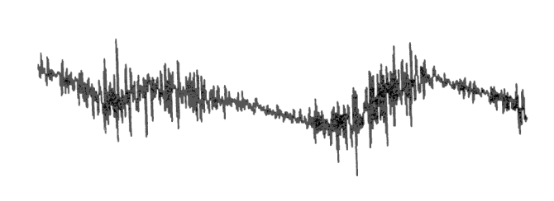
ECG Noise Supplemental⁹
Baseline Wander
Muscle Noise (EMG)
Powerline interference
Electrode Motion Artifact

Slide 27
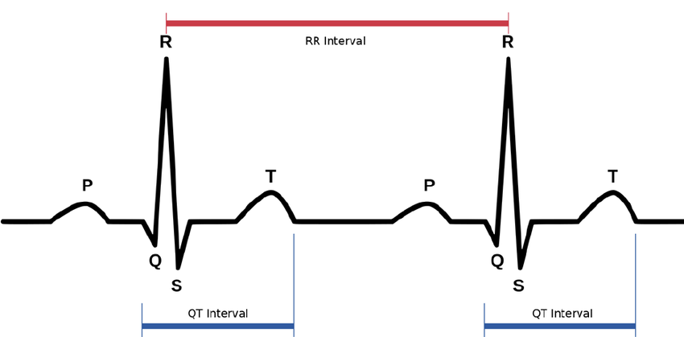
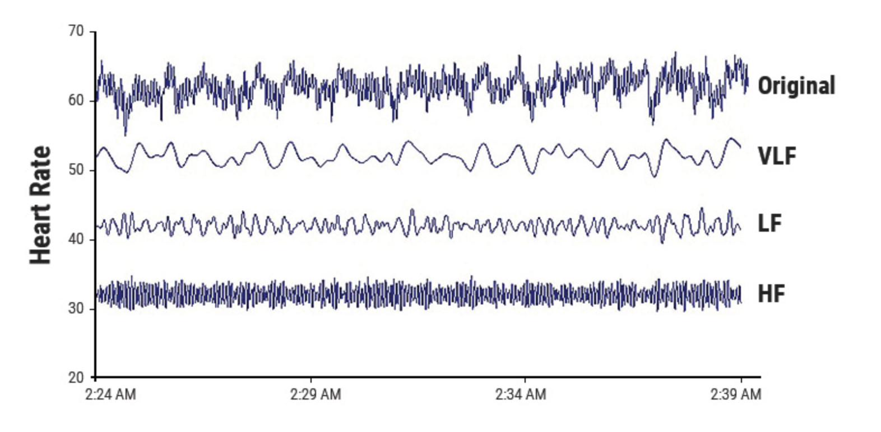
HRV Supplemental
ECG→R peak detection→ RR Intervals → Tachogram→ FFT and Power Spectral analysis→ Analysis
LF ranges from 0.04-0.15 Hz¹⁴
PNS, SNS, and BP regulation
HF ranges from 0.15-0.4 Hz¹⁴
parasympathetic/respiratory activity
Low power reflects stress
LF/HF Ratio
Reflects balance between SNS and PNS¹⁴
Avg ratio for males = 5.8(day)/3.4(night)¹⁴
Avg ratio for females = 4.4(day)/2.3(night)¹
Low LF/HF ratio associated with high levels of stress¹⁴
Power Spectral Analysis to determine LF and HF power
https://www.physiospot.com/research/why-physical-therapists-can-use-heart-rate-variability-hrv-as-a-measurement-tool/

Slide 28
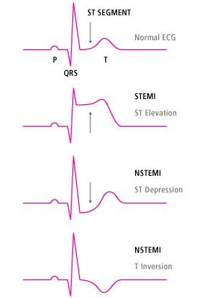
ECG Supplemental
Voltage over time of electrical signals within the heart
Signs of myocardial infarction:
ST elevation
ST depression
T wave inversion

Slide 29
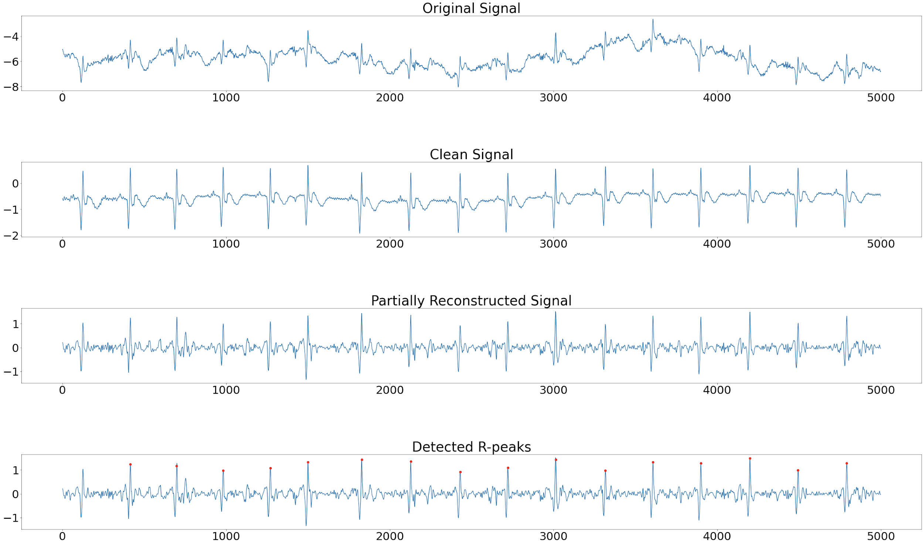
Wavelet Decomposition
Performs DWT on filtered signal
Reconstructs detail coefficients 3-5 of signal, which isolate R-peaks
Makes r-peak detection easier

Slide 30
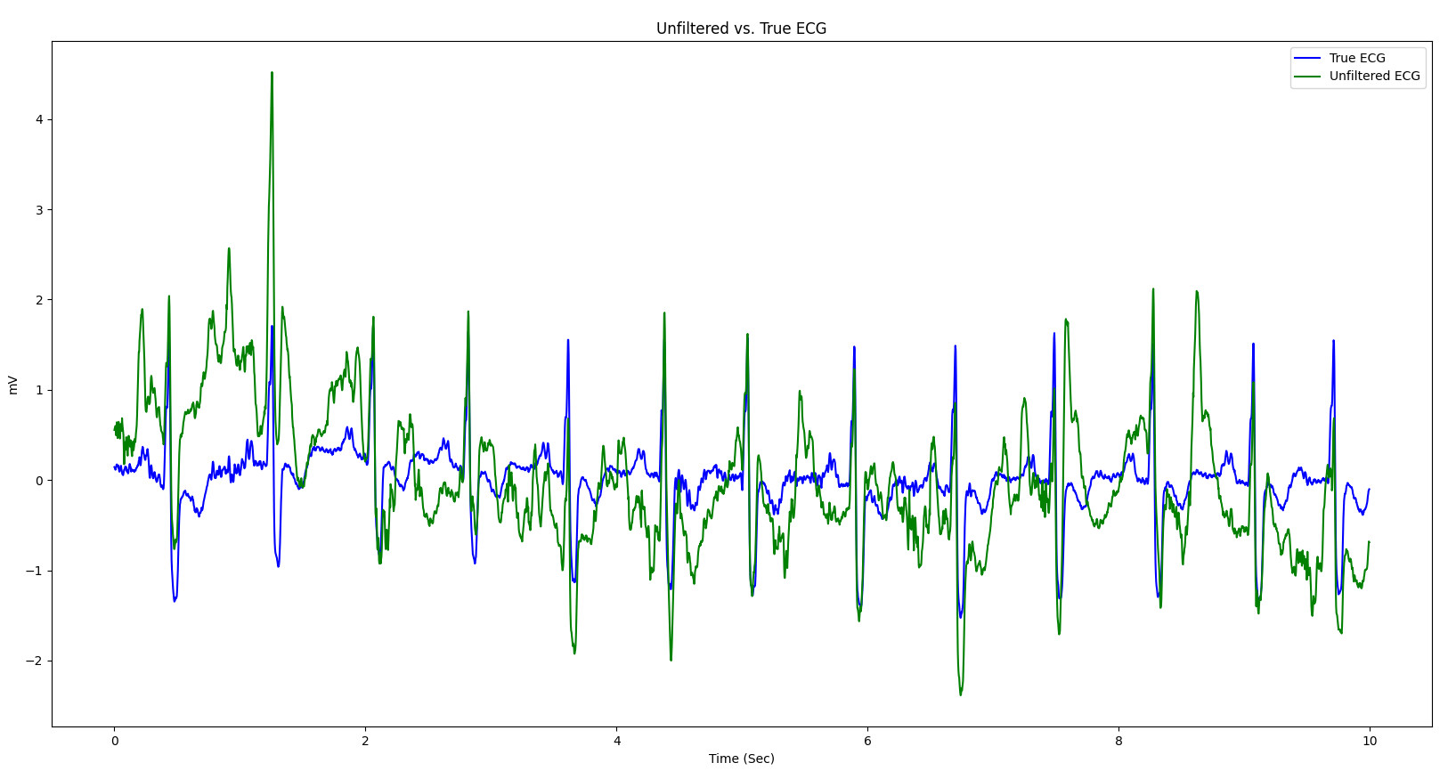
True Supplemental

Slide 31
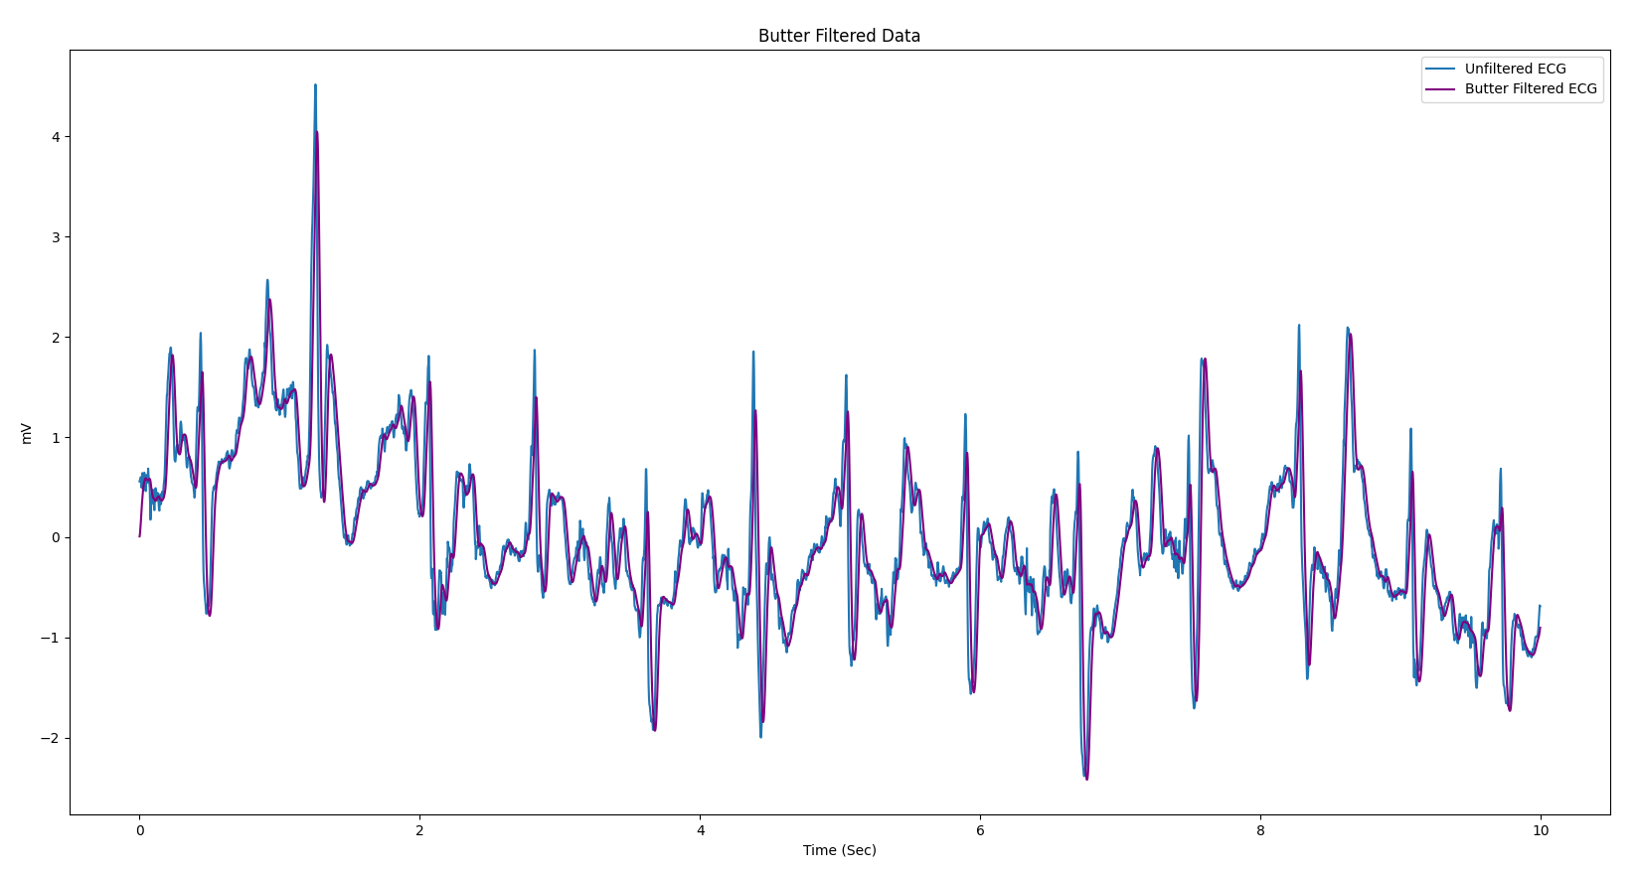
Butterworth Supplemental

Slide 32
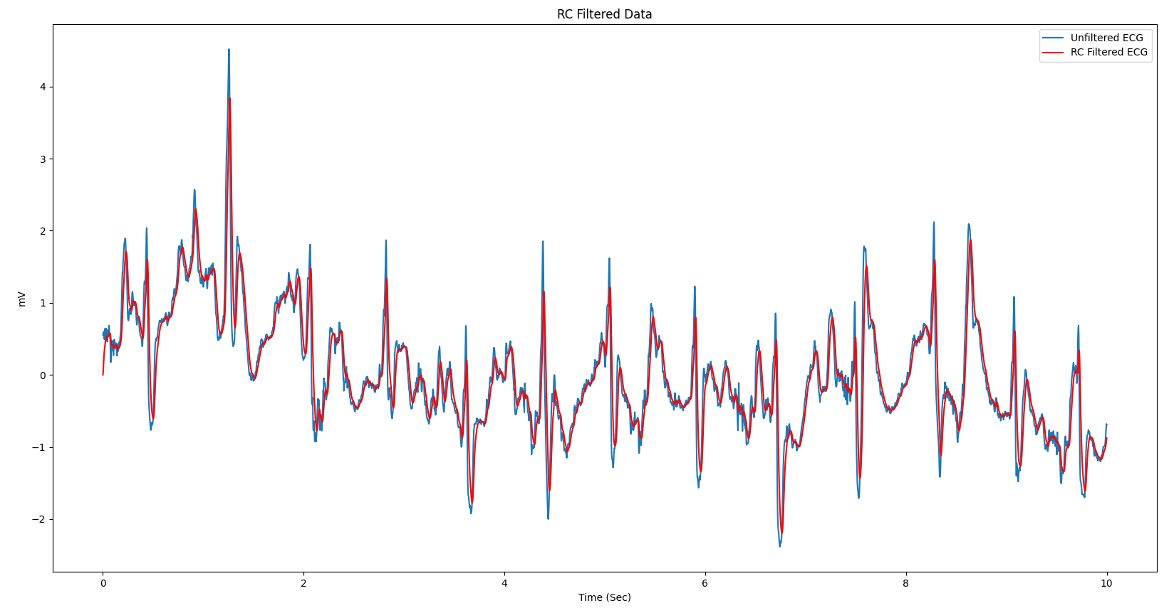
RC Supplemental

Slide 33
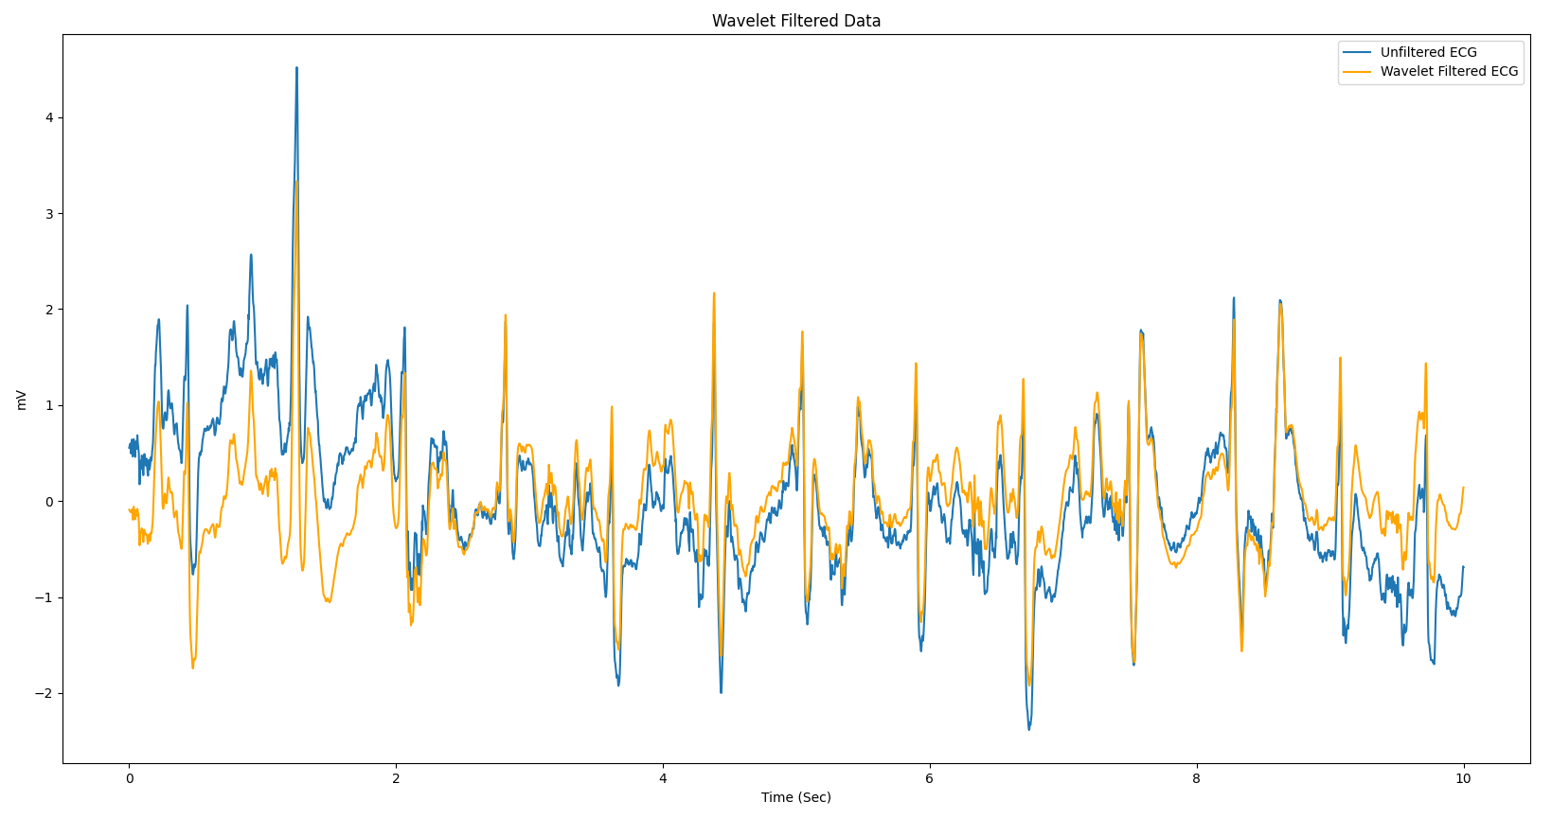
Wavelet Supplemental

